Slide 1



Slide 2

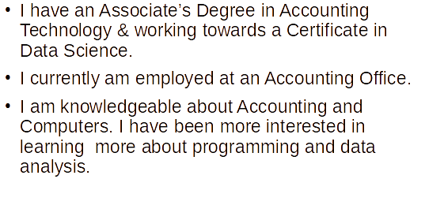
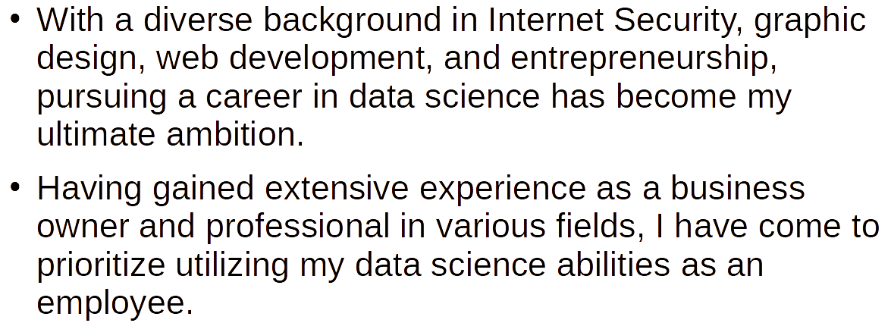
Krista
Kori -
Christophe -
Justin -

Slide 3
Background/History

Slide 4
Background/History

Slide 5
Methods Used

Slide 6
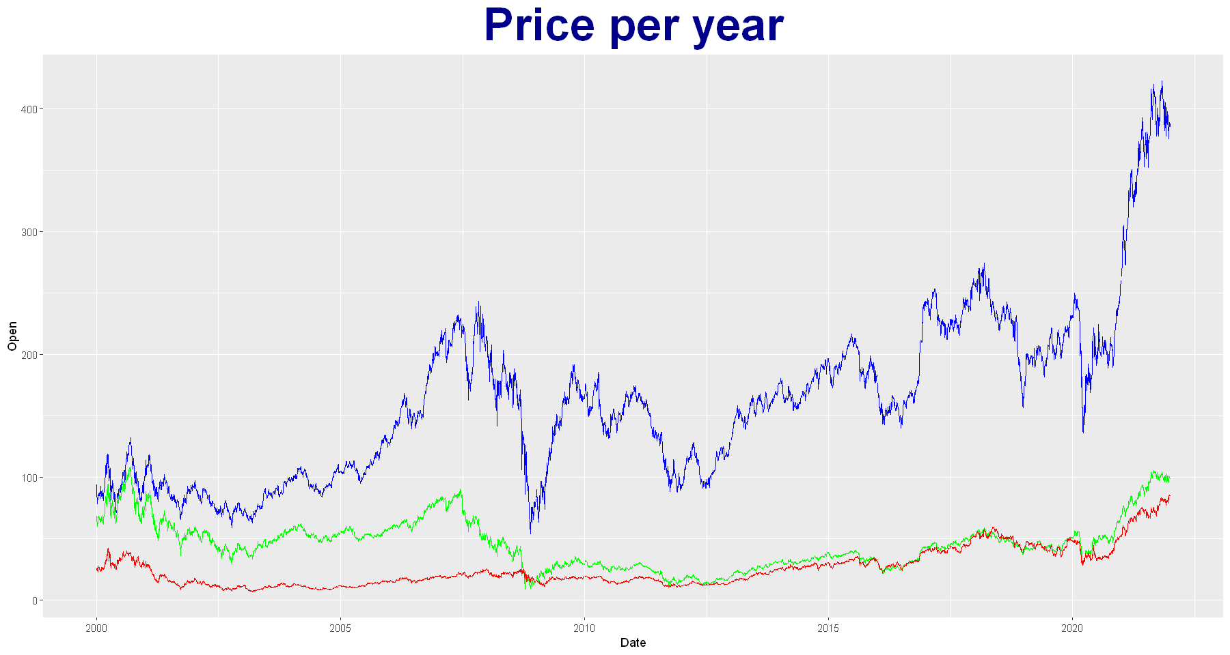
Goldman Sachs (blue)
Morgan Stanley (green)
Schwab (red)
Notes:
When speaking about stock volatility, you are looking at the rate in which a stock increases or decreases over a particular period. Goldman Sachs is the most volatile since the stock prices are a lot higher and have more risk than the stocks for Morgan Stanley and Schwab. Looking at the graph, you can see that Schwab would be the best stock option to buy when it comes to the volatility between the stock.

Slide 7
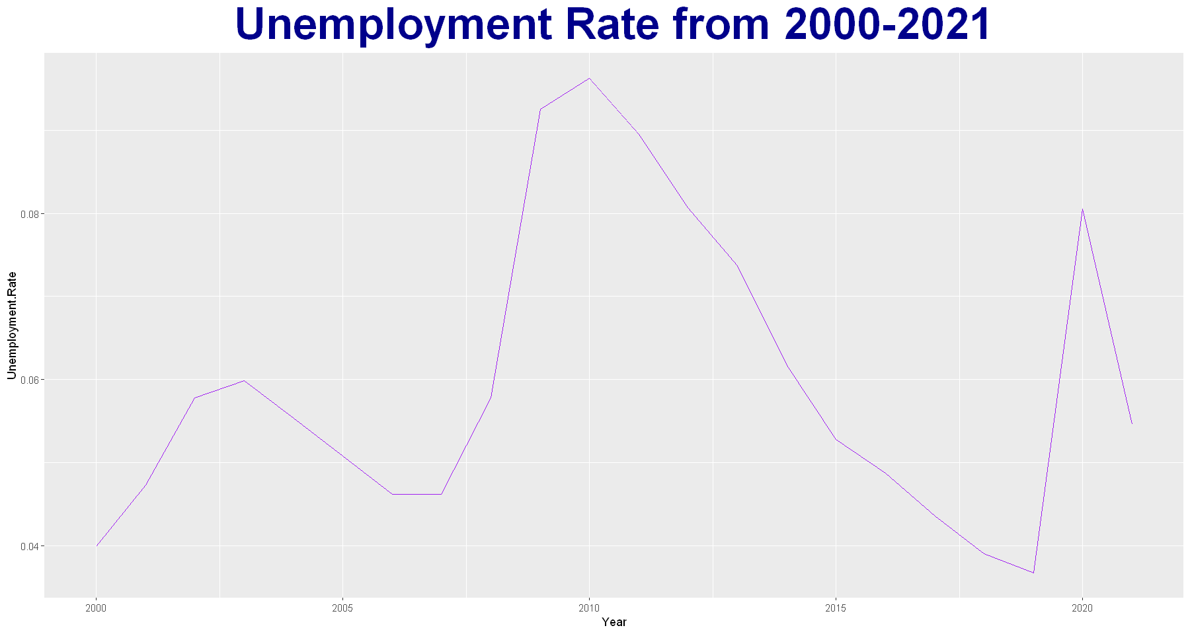
Notes:
The Unemployment Rate also played a factor in the rise & fall of the stocks. As the unemployment rate went up, the stock prices also increased. The Feds would lower interest rates which would in turn cause investors to buy more stocks.
Highest Unemployment Rate is in 2010, which is during the slow economic growth after the Great Recession.

Slide 8
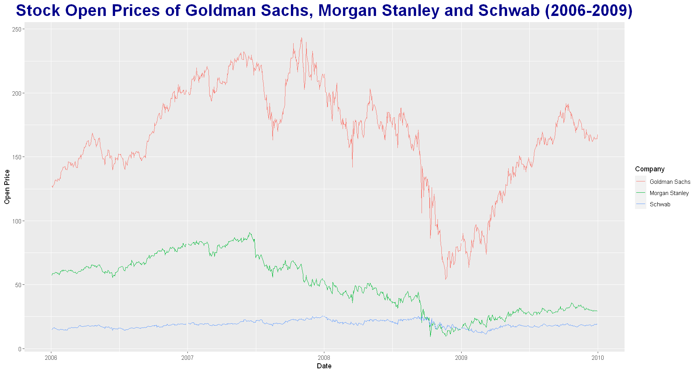
Notes:
When the Housing Market Crashed in 2006, more demand for stocks led to increased prices in stocks. As the Great Recession hit, the demand for stocks decreased therefore, the price decreased based off the demand of the stocks.
The predatory home loan private lending driven by the insatiable investor demand for mortgage-related investments that led up to the crash in 2008.
At the beginning of the Great Recession (December 2007), stock prices were up due to more demand of stocks. The stocks fluctuate throughout the first part of 2008 as the recession went on, stocks were not bought as much. September of 2008, Goldman Sachs stocks started going down at a faster pace than Morgan Stanley and Schwab due to stocks being sold due to less demand. Near the end of the Recession in 2008, the demand for stocks started going up again. The Stock prices continued to rise through most of 2009, even after the Housing Market Crash ended July 2009.

Slide 9
Results - Kori

Slide 10
Results - Kori

Slide 11
Results - Krista

Slide 12
Results - Christophe

Slide 13
Summary

Slide 14
Conclusion

Slide 15
Questions?

